Slide 1

Online Attendance Management System
Group Members
1)Kunal Palande-20104031
2)Siddhant Darekar-20104111
3)Anmol Ahirwar-20104131
4)Kaif Khan-20104128
Project Guide
Ms. Geetanjali Kalme

Slide 2
Contents
Introduction
Objectives
Scope
Features / Functionality
Project Outcomes
Technology Stack
Block Diagram

Slide 3
1. Introduction
The software system is based on inserting, deleting and updating of database management system.
Locate and Address Inefficiencies.
The purpose of developing attendance management system is to computerized the tradition way of taking attendance.
Attendance Management System is a software developed for daily student attendance in schools,colleges and institutes.

Slide 4
2. Objectives
Each staff will be given with a separate username and password based on the subject they handle.
Make the attendance system computerized
Reduce time consumption
Paper work is reduced as we need not to maintain registers for future references.
Increased Accuracy and reliability.

Slide 5
3. Scope
This project has much scope both in present as well as future. In present situation the system can be accessed both in laptop and mobile devices.
In future the system can be automated using students fingerprint.

Slide 6
4. Feature /Functionality
1. Clocking-in and out
A very essential feature of an attendance management system is clocking in and out. Student should be able to sign in, schedule punch-in break times, and then sign out at the end of the day.
2. Authentication
Students will have unique login id.
3.Simply requires an internet connection to run smoothly.

Slide 7
5. Outcome of Project
A simple online attendance app designed for all attendance requirements.
Capable of storing student attendance data records.
Fully compatible with both the web & mobile devices.
Connects teachers and students on-the-go.

Slide 8
6. Technology Stack
Before entering into the system (home page), the user must login, for this purpose the log in page is created. This log in form is made for security purpose i.e. only authenticated users have access into the system, i.e. either administrator or the user.
Front End :-java.
Back End:-MySQL

Slide 9
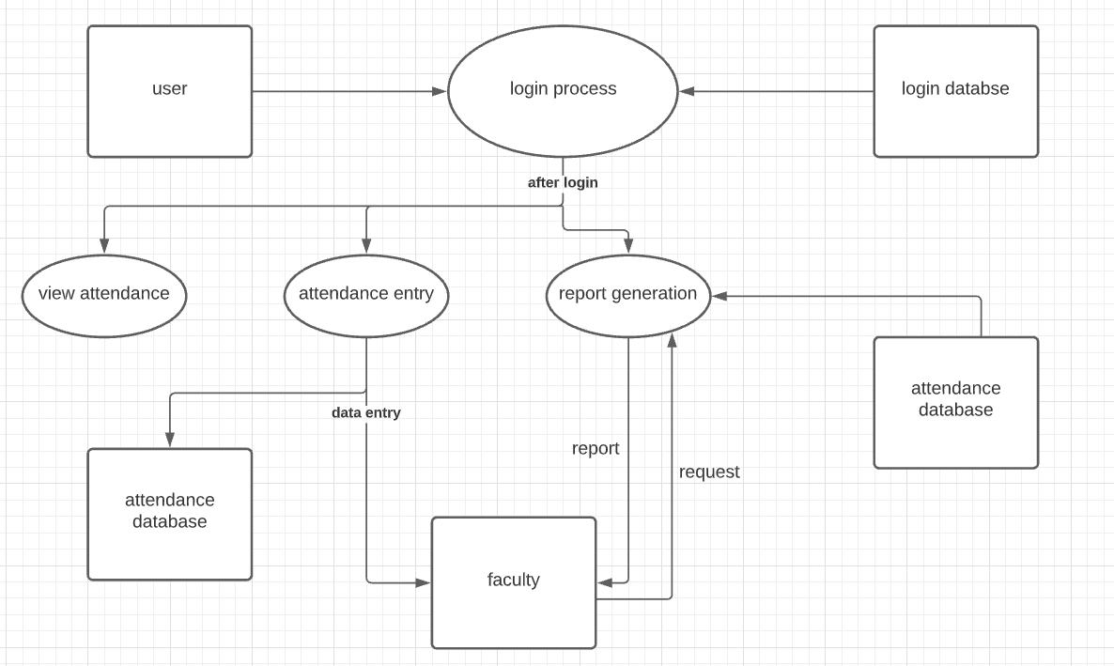
7. Block Diagram

Slide 10
Thank You...!!

